Slide 1
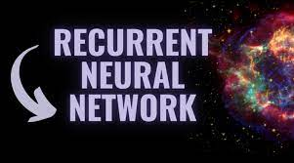
Dr. Amit Sinhal
Professor
Department of Computer Science & Engineering

Slide 2
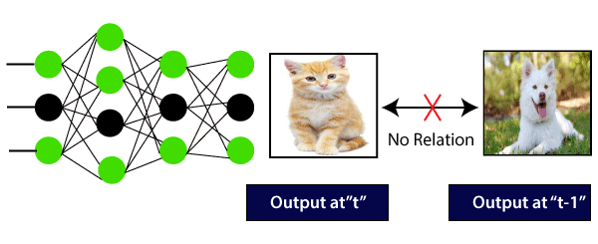
Consider A Feed Forward Network:
Here, the first output being a cat will not influence the previous output, which is a dog.
This means that output at a time 't' is autonomous of output at the time 't-1?.

Slide 3
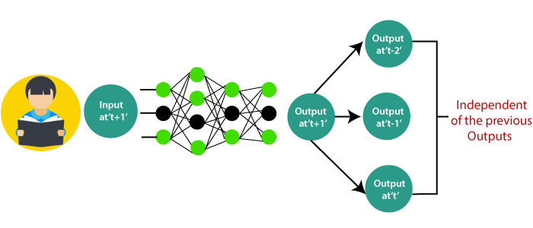
Consider another scenario
The concept is the same as reading a book. With every page we move forward into, we need the understanding of previous pages to make complete sense of the information in most of the cases.
With the help of the feed-forward network, the new output at the time 't+1? has no relation with outputs at either time t, t-1, t-2.
So, the feed-forward network cannot be used when predicting a word in a sentence as it will have no absolute relation with the previous set of words.

Slide 4
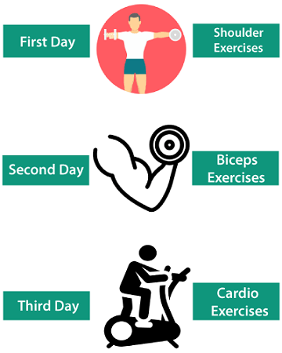
Consider another scenario
We go to the gym regularly, and the trainer has given us the schedule of our workout:
Note that all the exercises are repeated in a proper order every week.

Slide 5
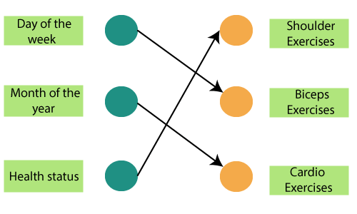
Let us use a feed-forward network to trying and predicting the types of exercises.
The inputs are the day, month, and health status. A neural network has been trained using these inputs to provide the prediction of the exercise.

Slide 6
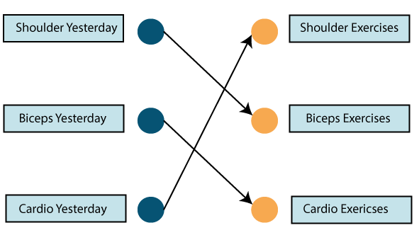
However, this will not very accurate, considering the input. To fix this, we make use of the concept of Recurrent Neural Networks, as shown below:
In this case, find the inputs to be workout done on the previous day.
So if we did a shoulder exercise yesterday, we could do a bicep exercise today, and this goes on for the rest of the week.

Slide 7
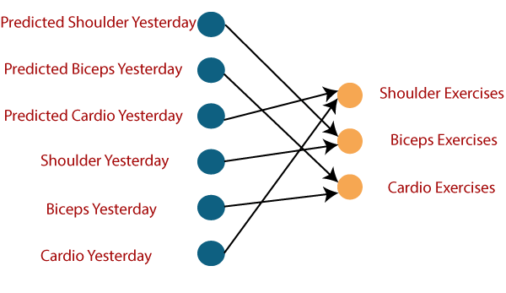
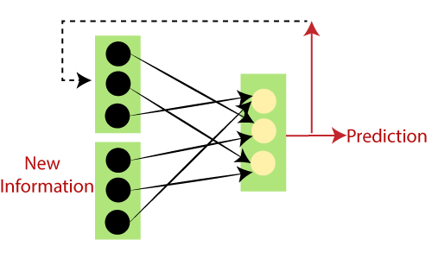
However, if we happen to miss a day at the gym, the data from the previously attended timestamp can be considered below:
If a model is experienced based on the data it obtains from the last exercises, the output from the model will be accurate.
So, if we have a shoulder exercise, the corresponding node will be '1', and the rest of the exercise nodes will be mapped to '0'.

Slide 8
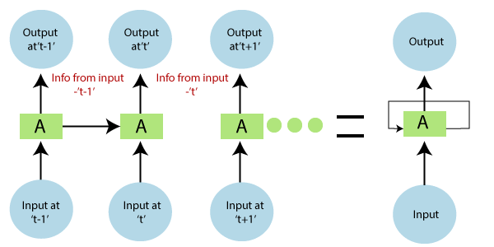
In the above diagram, we have specific inputs at-1? which is fed into the network. These inputs will lead to parallel outputs at time 't-1' as well.
In the next timestamp, information from the previous input't-1? is provided along with input at't? to provide the output at 't eventually.'
This process repeats itself, to ensure that the latest inputs are aware and can use the information from the previous timestamp is obtained.

Slide 9
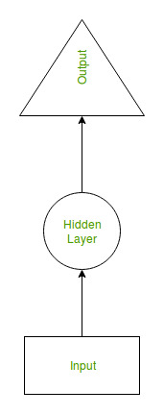
Recurrent Neural Network(RNN) is a type of Neural Network where the output from the previous step are fed as input to the current step.
In traditional neural networks, all the inputs and outputs are independent of each other, but in cases like when it is required to predict the next word of a sentence, the previous words are required and hence there is a need to remember the previous words.
Thus RNN came into existence, which solved this issue with the help of a Hidden Layer.
The main and most important feature of RNN is Hidden state, which remembers some information about a sequence.

Slide 10
Why Recurrent Neural Networks?
RNN were created because there were a few issues in the feed-forward neural network:
Cannot handle sequential data
Considers only the current input
Cannot memorize previous inputs
The solution to these issues is the RNN.
An RNN can handle sequential data, accepting the current input data, and previously received inputs. RNNs can memorize previous inputs due to their internal memory.

Slide 11
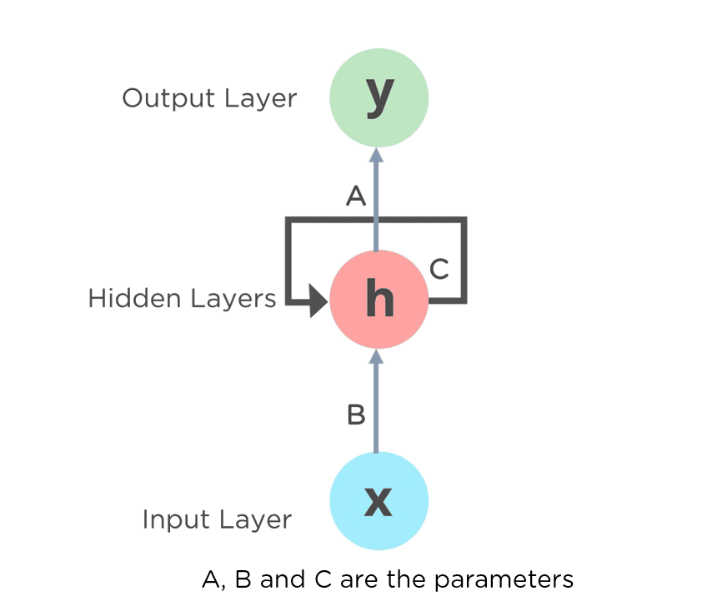
What is a Recurrent Neural Network
A recurrent neural network (RNN) is a special type of artificial neural network adapted to work for time series data or data that involves sequences.
Ordinary feed forward neural networks are only meant for data points that are independent of each other. However, if we have data in a sequence such that one data point depends upon the previous data point, we need to modify the neural network to incorporate the dependencies between these data points.
RNNs have the concept of “memory” that helps them store the states or information of previous inputs to generate the next output of the sequence.

Slide 12
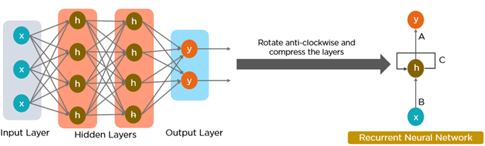
Recurrent Neural Networks (RNN)
All of the inputs and outputs in standard neural networks are independent of one another, however in some circumstances, such as when predicting the next word of a phrase, the prior words are necessary, and so the previous words must be remembered.
As a result, RNN was created, which used a Hidden Layer to overcome the problem. The most important component of RNN is the Hidden state, which remembers specific information about a sequence.
RNNs have a Memory that stores all information about the calculations. It employs the same settings for each input since it produces the same outcome by performing the same task on all inputs or hidden layers.

Slide 13
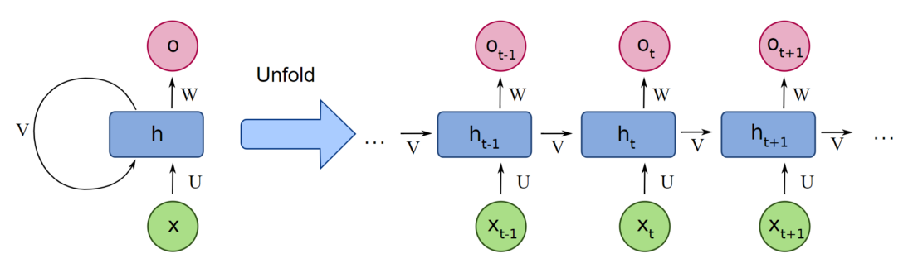
Unfolding a Recurrent Neural Network
Feed-forward neural networks are poor predictions of what will happen next because they have no memory of the information they receive. Because it simply analyses the current input, a feed-forward network has no idea of temporal order.
The information is in an RNN cycle via a loop. Before making a judgment, it evaluates the current input as well as what it has learned from past inputs.
RNN, on the other hand, may recall due to internal memory. It produces output, copies it, and then returns it to the network.

Slide 14

How Does RNN Works
The different activation functions, weights, and biases will be standardized by the Recurrent Neural Network, ensuring that each hidden layer has the same characteristics. Rather than constructing numerous hidden layers, it will create only one and loop over it as many times as necessary.

Slide 15
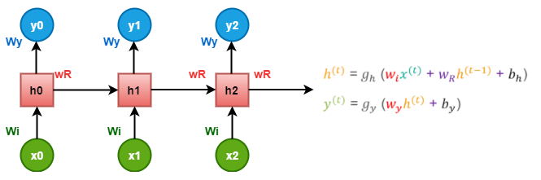
At time t=0, the input is 'x0, and the task is to figure out what is 'h0'. Substituting t=0 in the equation and acquiring the function h(t) value. The next value of 'y0' is finding out using the previously calculated values when applied to the new formula.
The same process is repeated through all of the timestamps in the model to train a model.

Slide 16
Training through RNN
The network takes a single time-step of the input.
We can calculate the current state through the current input and the previous state.
Now, the current state through h_{t-1} for the next state.
There is n number of steps, and in the end, all the information can be joined.
After completion of all the steps, the final step is for calculating the output.
At last, we compute the error by calculating the difference between actual output and the predicted output.
The error is back-propagated to the network to adjust the weights and produce a better outcome.

Slide 17
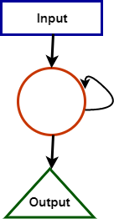
Training through RNN
For calculating the current state-
h_{t} =f(h_{t-1}, X_{t})
Where h_{t}= current state h_{t-1}= previous state X_{t}= input state
To apply the activation function tanh, we have-
ht = tanh (W_{hh}h_{t}-1+ W_{xh}X_{t})
Where:
W_{hh} = weight of recurrent neuron and, W_{xh} = weight of the input neuron
The formula for calculating output:
Y_{t} = W_{hy}h_{t}

Slide 18
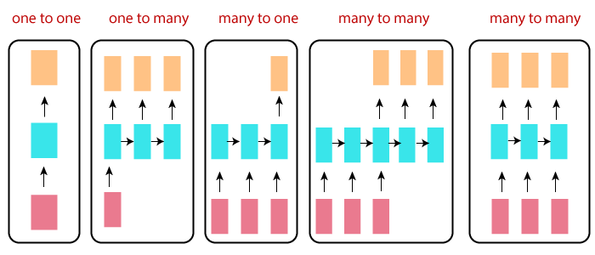
Types of Recurrent Neural Networks
There are four types of Recurrent Neural Networks:
One to One
One to Many
Many to One
Many to Many

Slide 19
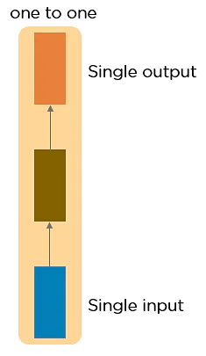
Types of Recurrent Neural Networks
One to One RNN
This type of neural network is known as the Vanilla Neural Network. It's used for general machine learning problems, which has a single input and a single output.
This is also called Plain Neural networks. It deals with a fixed size of the input to the fixed size of output, where they are independent of previous information/output.
Example: Image classification.

Slide 20
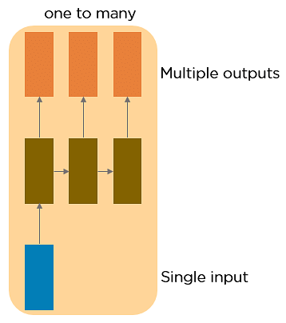
Types of Recurrent Neural Networks
One to Many RNN
This type of neural network has a single input and multiple outputs. An example of this is the image caption.
It deals with a fixed size of information as input that gives a sequence of data as output.
Example: Image Captioning takes the image as input and outputs a sentence of words.

Slide 21
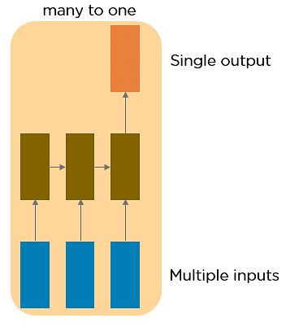
Types of Recurrent Neural Networks
Many to One RNN
This RNN takes a sequence of inputs and generates a single output. Sentiment analysis is a good example of this kind of network where a given sentence can be classified as expressing positive or negative sentiments.
It takes a sequence of information as input and outputs a fixed size of the output.
Example: sentiment analysis
where any sentence is classified as
expressing the positive or negative
sentiment.

Slide 22
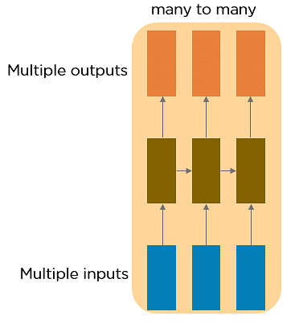
Types of Recurrent Neural Networks
Many to Many RNN
This RNN takes a sequence of inputs and generates a sequence of outputs. Machine translation is one of the examples.
It takes a Sequence of information as input and processes the recurrently outputs as a Sequence of data.
Example: Machine Translation,
where the RNN reads any sentence
in English and then outputs the
sentence in French.

Slide 23
Types of Recurrent Neural Networks
Bidirectional Many-to-Many:
Synced sequence input and output. Notice that in every case are no pre-specified constraints on the lengths sequences because the recurrent transformation (green) is fixed and can be applied as many times as we like.
Example:
Video classification where
we wish to label every frame
of the video.

Slide 24
Two Issues of Standard RNNs
1. Exploding Gradient Problem
While training a neural network, if the slope tends to grow exponentially instead of decaying, this is called an Exploding Gradient. This problem arises when large error gradients accumulate, resulting in very large updates to the neural network model weights during the training process.
2. Vanishing Gradient Problem
RNNs suffer from the problem of vanishing gradients. The gradients carry information used in the RNN, and when the gradient becomes too small, the parameter updates become insignificant. This makes the learning of long data sequences difficult.
Long training time, poor performance, and bad accuracy are the major issues in gradient problems.

Slide 25
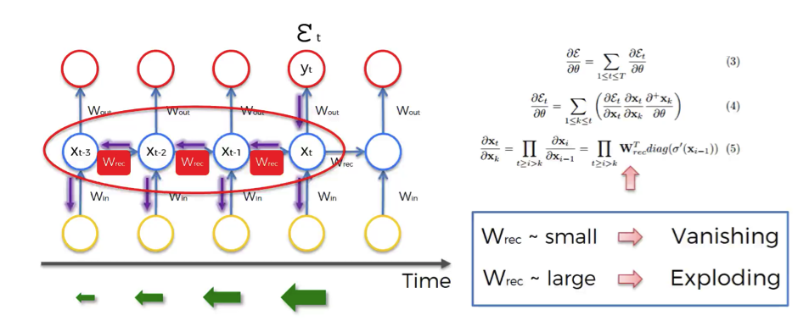
Two Issues of Standard RNNs

Slide 26
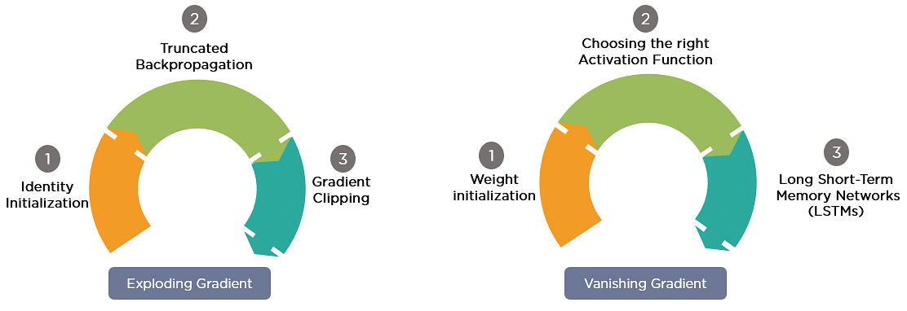
Gradient Problem Solutions
Exploding gradients | Vanishing gradients
Truncated BTT Instead of starting back propagation at the large timestamp, we can choose a smaller timestamp like 10 | ReLU activation function We can use activation like ReLU, which gives output one while calculating the gradient
Clip gradients at the threshold Clip the gradient when it goes more than a threshold | LSTM, GRUs The different network architecture that has been specially designed can be used to overcome this problem

Slide 27
RNN Applications
Recurrent Neural Networks are used to tackle a variety of problems involving sequence data, including :
Speech recognition
Generation of music
Automated Translations
Analysis of video action
Sequence study of the genome and DNA
Language Modeling and Generating Text
Time series Forecasting

Slide 28
RNN Advantage and Drawbacks
Advantages | Drawbacks
Ability to handle sequence data Ability to handle inputs of varying lengths Ability to store or “memorize” historical information Model size not increasing with size of input Computation takes into account historical information Weights are shared across time | Computation being slow Difficulty of accessing information from a long time ago Cannot consider any future input for the current state Gradient vanishing and exploding problems.

Slide 29
Different RNN Architectures
Bidirectional Recurrent Neural Networks (BRNN)
In BRNN, inputs from future time steps are used to improve the accuracy of the network. It is like knowing the first and last words of a sentence to predict the middle words.
Long Short Term Memory (LSTM)
LSTMs were also designed to address the vanishing gradient problem in RNNs. LSTMs use three gates called Input, Output, and Forget gate. These gates determine which information to retain.
Gated Recurrent Units (GRU)
These networks are designed to handle the vanishing gradient problem. They have a Reset and Update Gate. These gates determine which information is to be retained for future predictions.

Slide 30
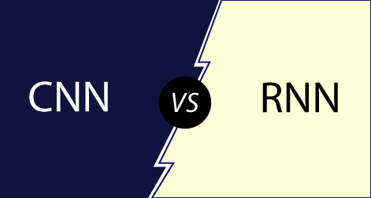
S.no | CNN | RNN
1 | CNN stands for Convolutional Neural Network. | RNN stands for Recurrent Neural Network.
2 | CNN is ideal for images and video processing. | RNN is ideal for text and speech Analysis.
3 | It is suitable for spatial data like images. | RNN is used for temporal data, also called sequential data.
5 | The network takes fixed-size inputs and generates fixed size outputs. | RNN can handle arbitrary input/ output lengths.
6 | CNN is a type of feed-forward artificial neural network with variations of multilayer perceptron's designed to use minimal amounts of preprocessing. | RNN, unlike feed-forward neural networks- can use their internal memory to process arbitrary sequences of inputs.
7 | CNN's use of connectivity patterns between the neurons. CNN is affected by the organization of the visual cortex, whose individual neurons are arranged in such a way that they can respond to overlapping regions in the visual field. | Recurrent neural networks use time-series information- what a user spoke last would impact what he will speak next.

